Slide 1
Introduction to OpenLane
Workshop Session 2
Presented by
Hafiz Wajeh ul Hasan

Slide 2
Contents
OpenLane
PDK
Foundry
Prerequisites for an ASIC Design
Sky130 PDK
LAB PRACTICE

Slide 3
OpenLane
What is OpenLane?
OpenLane is an automated RTL to GDSII flow
The flow performs full ASIC implementation steps from RTL all the way down to GDSII
Amalgamation of open-source Electronic design automation (EDA) Tools

Slide 4
Design.v, Design.sdc, Std_cells.lef, Std_cells.lib
Input
Synthesis
Yosys, OpenSTA
Design_gate_level_netlist.v
Output
Design_gate_level_netlist.v, macro.lef, macro.cfg
Input
Floorplan/Power Network
init_fp, ioplacer, pdn
Floorplan.def
Output
Floorplan.def
Input
Placement
RePLace,OpenDP
Placement.def
Output
Open-source EDA Tools
OpenLane
Design_gate_level_netlist.v, Placement.def
Input
CTS
TritonCTS
CTS.def, CTS_netlist.v
Output
Input
Routing
FastRoute, TritonRoute
CTS.def
Routing.def
Output
Input
RC Extraction
SPEF-Extractor
Routing.def
Design.spef
Output
Input
GDS Generation
Magic
Input
Routing.def
Output
Output
Design.gds, Design.lef
Input
Physical Verification
APR Step
Design.gds
Magic
EDA Tool

Slide 5
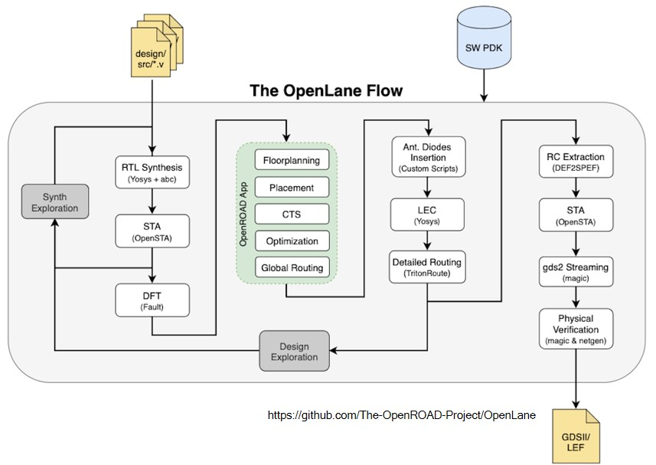
OpenLane Flow
The inputs of the flow?
Design.v/RTL
PDK
What is a PDK?

Slide 6



PDK (Process Design Kit)
It's a set of libraries and associated data to design in a particular technology
Simpler terms- A PDK contains:
Transistors
Standard Cells (for digital design)
Design Rules
Timing/Power Information etc. in library file
Layer information
G
S
D
$$n^{+}$$
$$n^{+}$$
Feature Size
$$p^{+}$$
Technology
130nm
90nm
65nm
45nm
30nm
Feature Size

Slide 7
Foundry
Who provides the PDK?
FOUNDRY!
What is a Foundry?
It is a factory where devices such as ICs are manufactured
Foundry
PDK
You
You
Fabrication
Designing
Foundry
Completed
GDS
Completed
ICs

Slide 8
Prerequisites for an ASIC Design
3 key ingredients
RTL/Design
EDA Tools
PDK
PDK
RTL
EDA TOOLS
RTL – You can write on your own
EDA TOOLS – You can find open-source tools
PDK - ??????
RTL
EDA TOOLS
PDK
Until June 2020, the open-source community did not have any solution for accessing PDK!
ASIC DESIGN

Slide 9
Sky130 PDK
First ever open-source PDK
Multiple process libraries
High speed
High density etc.
Contains Standard cells operated at 1.8V
1 level of local interconnect, 5 levels of metal

Slide 10
LAB PRACTICE

